Slide 1
Credit Card Fraud Detection
Machine Learning Project
Batch 1
1. Rohith Somella (TL)
2. Aman Bansal
3. Md. Feroz
4. Md Aman
5. Praful Kamath
6. Yaseen

Slide 2

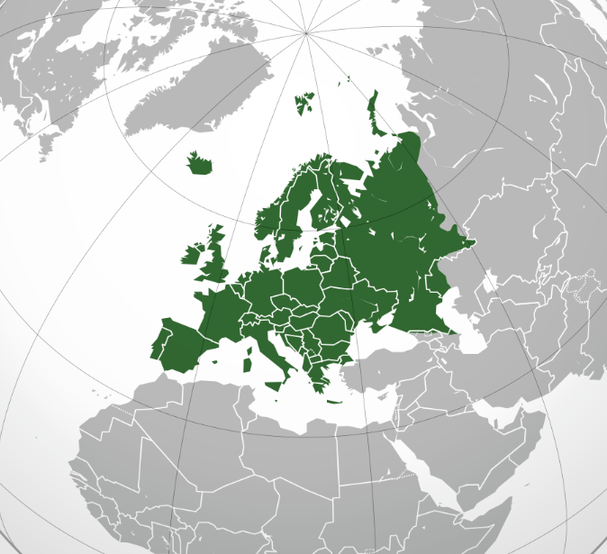
Abstract
The dataset contains credit card transactions made by European cardholders over a two-day period in September 2013.
There are a total of 284,807 transactions in the dataset, of which 492 (0.17%) are fraudulent and 284,315 (99.83%) are non-fraudulent.
The dataset includes 30 numerical features, labelled V1 through V28, the original features are not provided in the dataset due to confidentiality concerns.

Slide 3
Introduction
Credit card fraud is a serious problem that impacts the Banking Sector.
Accurate detection of fraudulent activities is essential to prevent losses and maintain customer trust.
Multiple supervised machine learning algorithms are we used for credit card fraud detection.
The dataset used for this project includes a certain number of records and features, and pre-processing steps were taken to clean and prepare the data.
Aim of our project is to give the best suitable model to get the reliable accuracy to predict the fraudulent transaction.

Slide 4
Content
1. Insights
Using python
Using Power BI
Using Seaborn
2. EDA
Handling Outlier and missing value analysis
Creating new dataset (partitioning and merging)
3. Data Split
Normalisation
Data sampling

Slide 5
Content
4. Model building phase 1
Logistic Regression
KNN
Decision Tree
5. Model Building phase 2
Ensemble Learning
Naive Bayes

Slide 6
Useful insights
Fraud transaction shape: (492, 31)
Legit transaction shape: (284315, 31)
Fraud:
Count: 284315
Mean: 88.291
Std: 250.105
Min: 0.00
25%: 5.65
50%: 22.0
75%: 77.05
Max: 25691.16
Legit:
Count: 492
Mean: 122.21
Std: 256.68
Min: 0.0
25%: 1.0
50%: 9.25
75%: 105.89
Max: 2125.87

Slide 7
Useful insights
Fetching outliers & time period
Number of rows that contains outliers: 4076
First & last transaction: 0.0 sec & 45:36 min
First & last fraud transaction: 7:16min & 47:31 min
First and last legit transaction: 0.0 sec & 47:3 min
Min & Max fraud transaction amount: 0.0 & 2125.87
Min & Max legit transaction amount: 0.0 & 25691.16

Slide 8
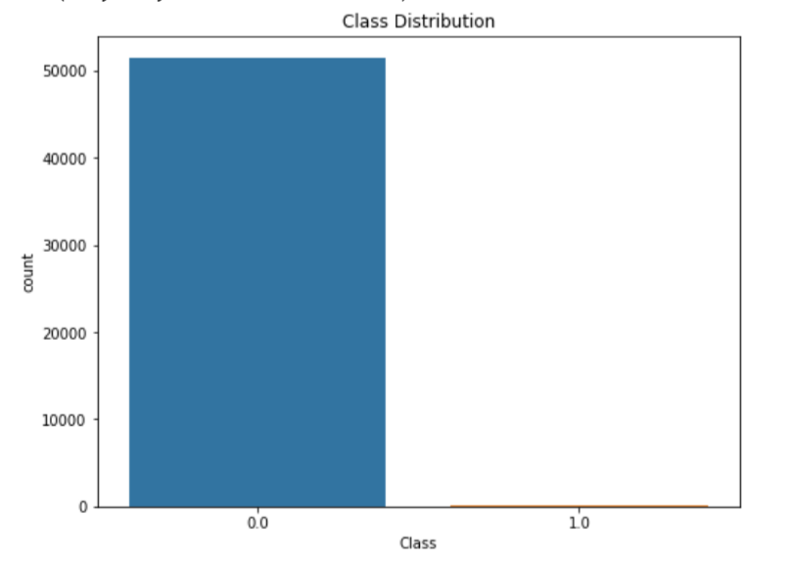
Count plot
We can observe from the plot that the dataset is highly imbalanced, with a much higher number of normal transactions than fraud transactions.
This imbalanced class distribution can pose challenges for building and evaluating machine learning models for fraud detection.

Slide 9
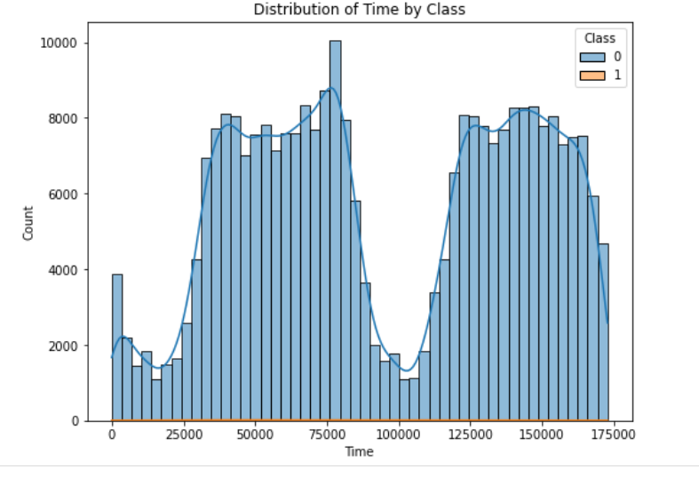
HISTOGRAM
.
The histogram plot shows the distribution of the "Time" feature in the dataset.
X-axis = Time in sec
Y-axis = Count of Transactions
The plot is colored by the transaction class, with Blue representing normal transactions and Orange representing fraud transactions.
By this plot we can see the Fraudulent transactions also evenly distributed throughout the period of time(which means both the days all the time)

Slide 10
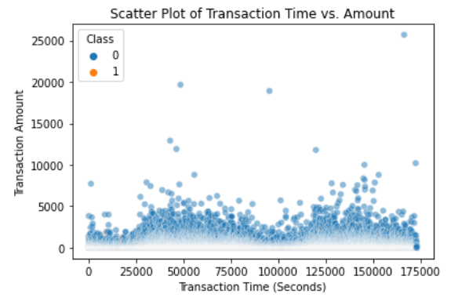
Scatter plot
X- axis = time
Y-axis = Amount of Transactions
However, there are also some fraud transactions with high transaction amounts and occurring at various times, indicating that fraudsters may adopt different strategies to avoid detection.

Slide 11
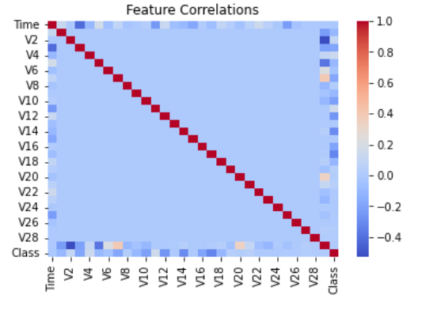
HEAT MAP
Heat maps show feature correlations in a dataset.
The heat map in this example uses a color scale to represent the strength of correlations.
Highly correlated features can be problematic for machine learning models.
Heat maps can help inform feature selection and model building decisions.

Slide 12
About the dataset
1. This dataset’s present transaction has occurred in two days, which we have 492 frauds
Out of 284315 transactions.
2. The dataset is highly unbalanced
3. Features v1,v2,……v28 are the principal
Components obtained with PCA (Principal component analysis)

Slide 13
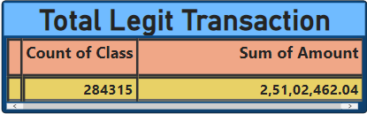
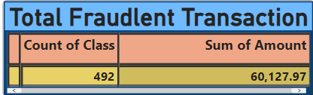
Total Legit Transaction
Total Fraudulent Transaction
Total genuine or Legit Transaction:
2,84,315.
Total amount of Legit transaction: 2,51,02,462.04
Total fraud transactions: 492
Total amount of fraud transaction:
60,127.97

Slide 14
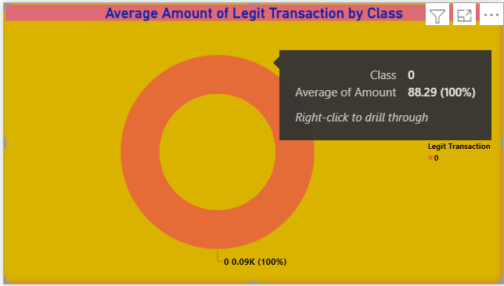
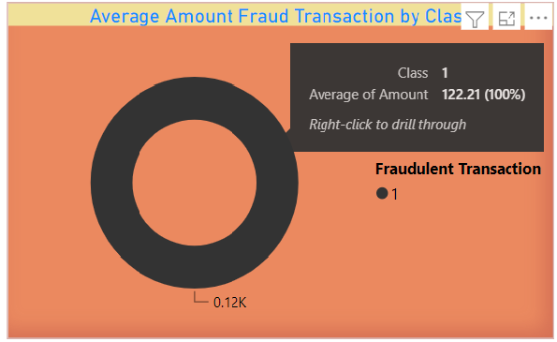
The Average Fraudulent Transactions are a bit higher then the Average Legit Transitions
Average amount of Legit Transaction
Average amount of fraud Transaction

Slide 15
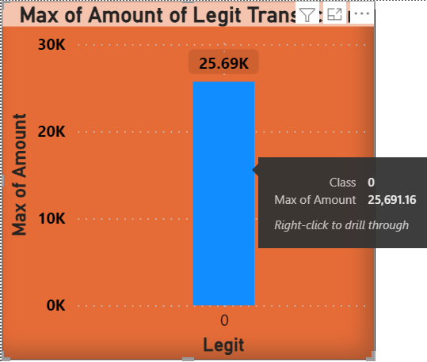
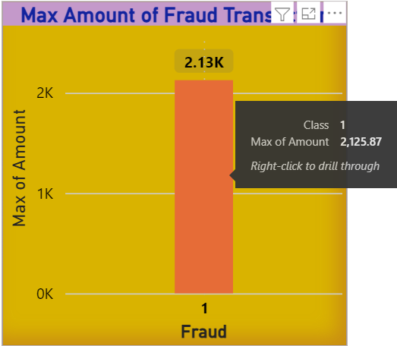
Maximum amount of Legit Transaction
Maximum amount of fraud transaction

Slide 16
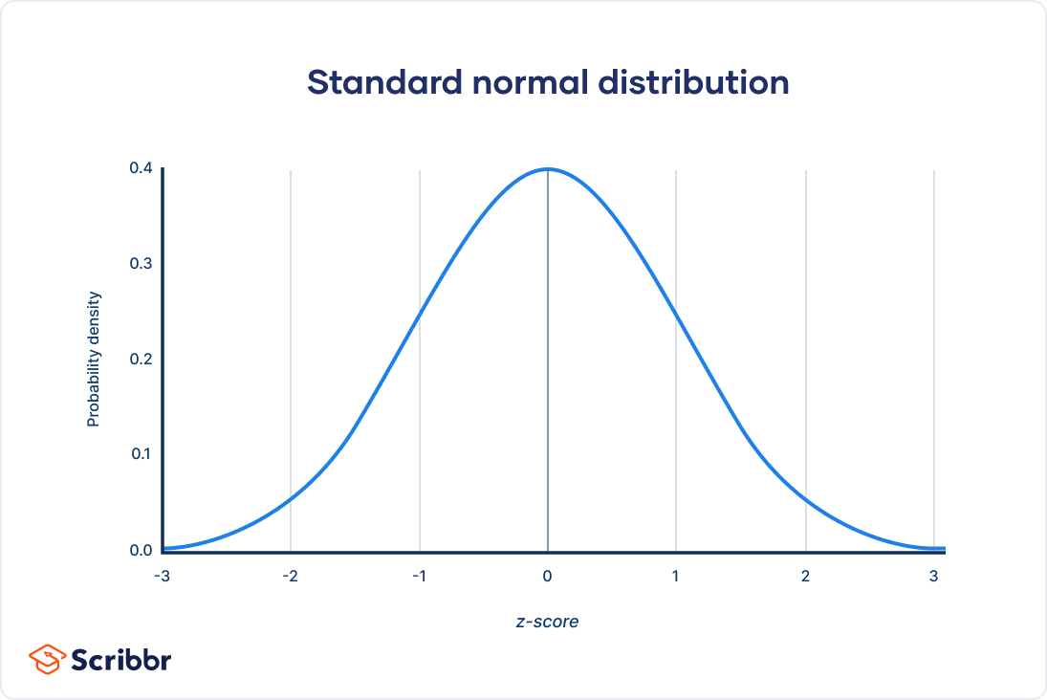
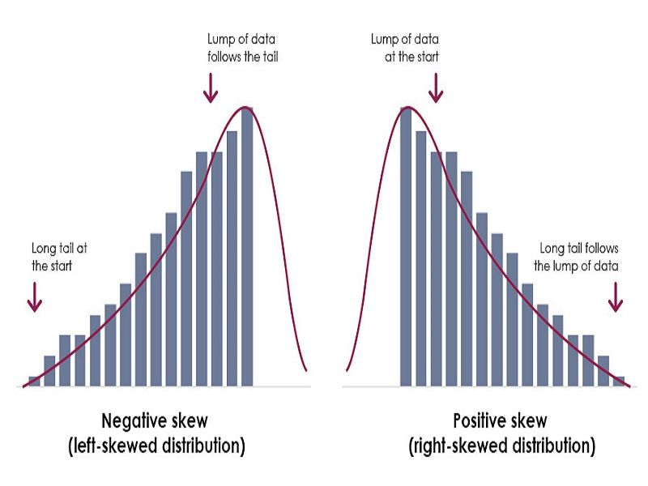
Distribution plots
Normal Distribution : - mean, median, and mode are placed at one point (skew -0.5 to 0.5)
Left Skew Distribution: - mean, median and mode placed at different points (skew -1 to -0.5)
Right Skew Distribution: - mean, median and mode placed at different points (skew 0.5 to 1)

Slide 17
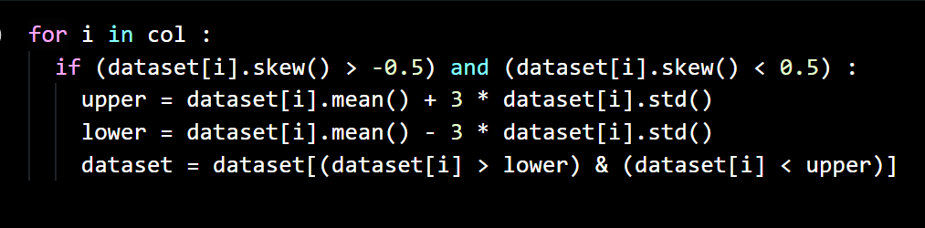
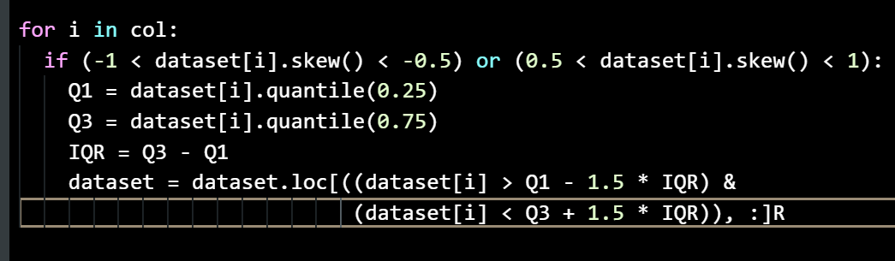
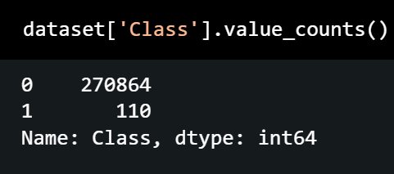
Outlier Handling
For Normal Distribution Z-Score Method
For Right and Left Skew Distribution IQR Method
Removing the Outlier Rows from all the columns
Leading to the loss of Important Data from the dataset
Fraud transaction: 492 to 110

Slide 18
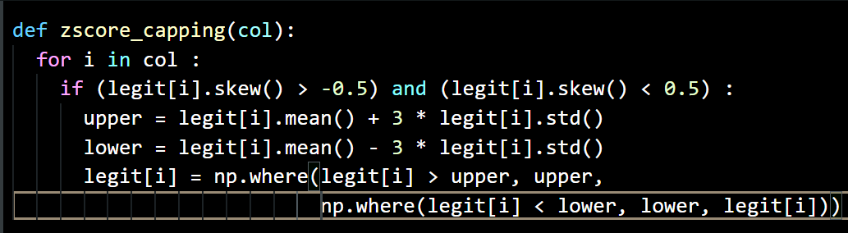
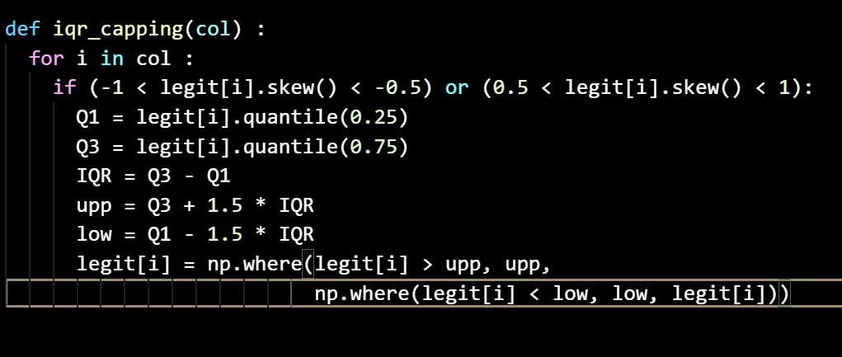
Outlier Handling
For Normal Distribution Z-Score Method
For Right and Left Skew Distribution IQR Method
Capping the Outlier Rows for all the columns
Replacing the upper and lower limit values
Fraud transaction: 492

Slide 19

Sampling
Sampling refers to the process of selecting a subset of data points from a larger dataset to use as training or testing data.
Under sampling: This technique involves reducing the number of data points from the overrepresented classes or categories to balance the dataset.
This can also be useful when the dataset is imbalanced.
Taking same number of both transactions to balance and concatenating in a new dataset.

Slide 20

Train Test Split
Train-test split is a common technique used in machine learning to split the dataset into training and testing data.
The training data is used to train the model, while the testing data is used to evaluate its performance.
Importing
After importing we get four different variables
X represnts independent variables
y represents dependent variable

Slide 21
Normalization
Normalization is a preprocessing step in machine learning that involves scaling numerical features.
Also called as feature scaling.
We have different techniques for feature scaling called as MinMax scaling and Standard scaling.
Formula for Standard scaling:
x_norm = (x - mean(x)) / std(x)

Slide 22
Hyperparameter tuning
Hyperparameter tuning is the process of finding the best set of hyperparameters for a machine learning model.
Hyperparameters are parameters that are set before training a model.
These parameters are not learned during the training process, but they are set by the user before starting the training.
Hyperparameter tuning can be performed in different ways such as grid search, random search, Bayesian optimization etc.
More details on hyperparameter tuning click here.

Slide 23
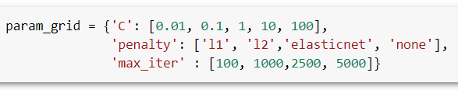




Hyperparameter tuning can be performed in several ways, such as:
Grid search: the user defines a set of hyperparameters and a range of values for each hyperparameter. The algorithm then searches through all possible combinations of hyperparameters to find the optimal set.
Defining param grid
Object creation and fitting
Importing Grid Search CV
Printing best parameters and best score

Slide 24
Supervised Machine Learning Algorithms
From scikit-learn Library of python
Logistic Regression
KNN (k-nearest neighbors)
Decision Tree

Slide 25
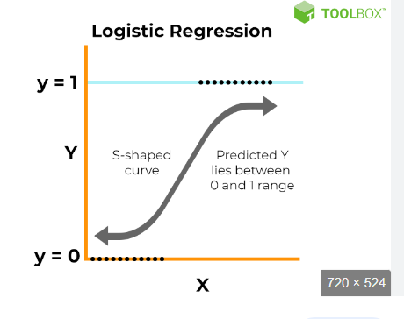
Logistic Regression
It is used to predict the dependent categorical target variable
It is used for the classification problem
This algorithm is inspired from the sigmoid function
sigmoid function Z=1/(1+e^-y)
Case1 : if y = ∞ Z = 1 Case2 : if y = - ∞ Z = 0

Slide 26
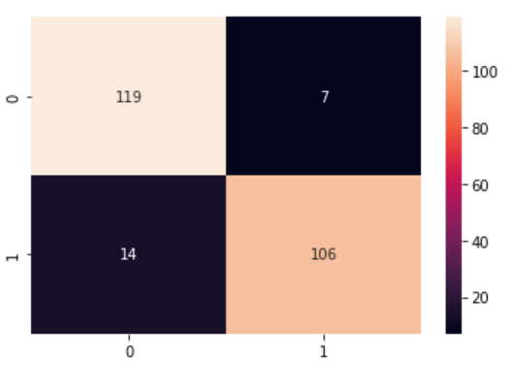
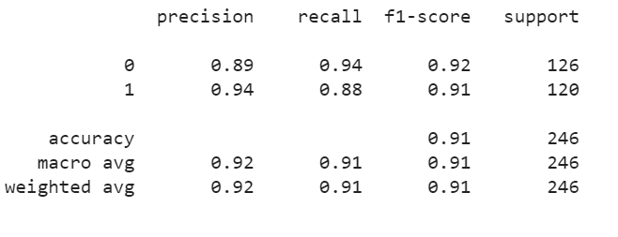
Logistic Regression
1. Before balancing the Data the accuracy is Accuracy = 99% , with low F1-score
2 .After balancing the Data the accuracy is Accuracy = 91%
F1-Score (0.91 & 0.92)
Classification Report :
Heatmap of confusion Matrix

Slide 27
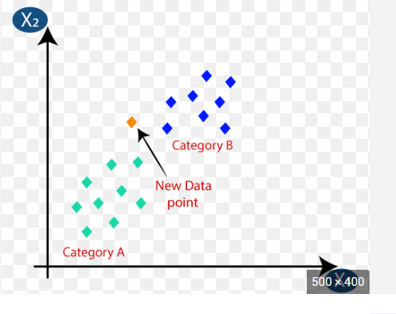
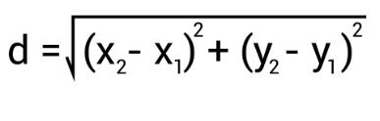
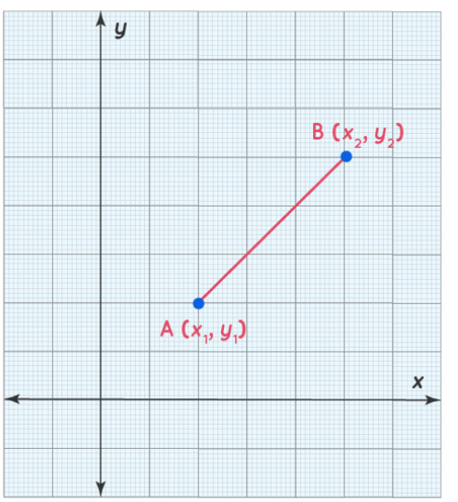
KNN- (k-nearest neighbors)
K-NN is a non-parametric algorithm
Where the number of points are high then the new value becomes to that family
We can calcualate the nearest point by using the eucledian distance
Eucledian distance

Slide 28
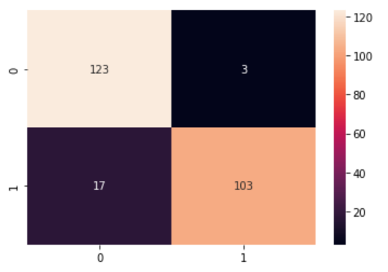
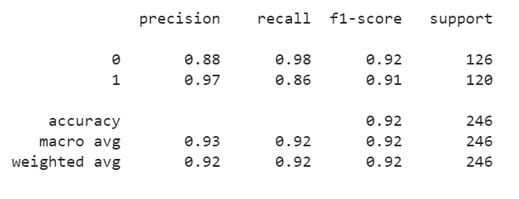
KNN- (k-nearest neighbors)
Before balancing the Data the accuracy is Accuracy = 100% , with low F1-score
After balancing the Data the accuracy is Accuracy = 92%
F1-Score: (0.91 & 0.92)
Classification Report :
Heatmap of confusion Matrix

Slide 29
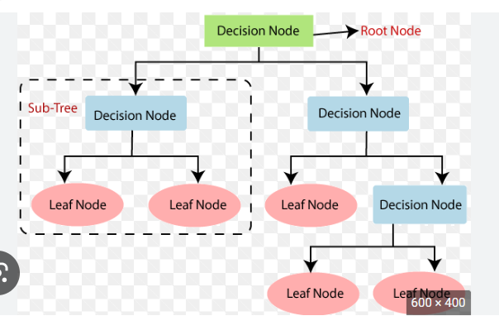
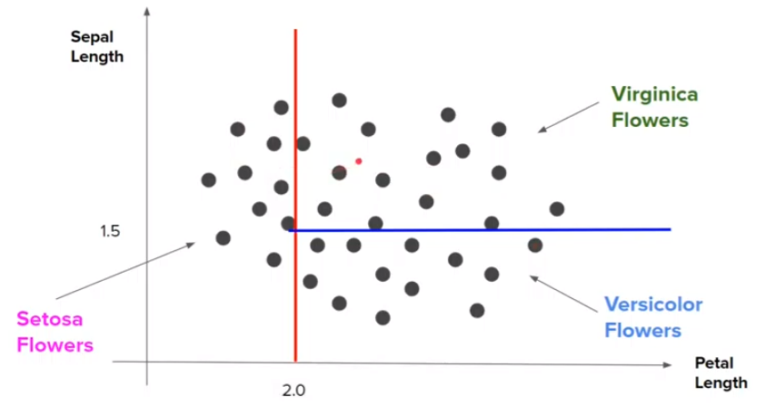
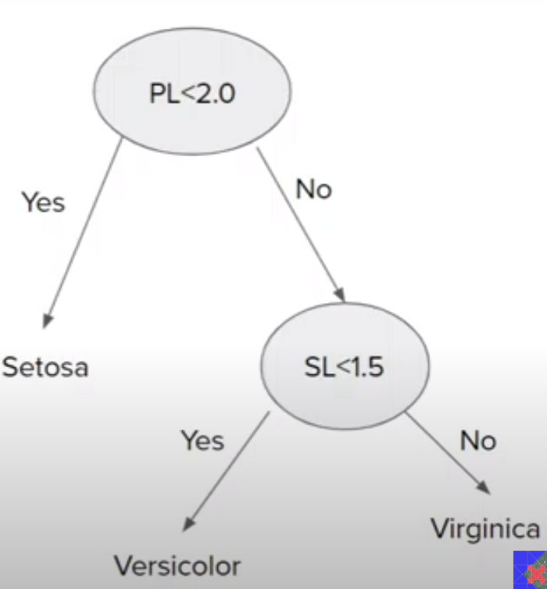
Decision Tree
It works similar to the if – else condition
It will form a tree like structure
there are two nodes, which are the Decision Node and Leaf Node.
Decision nodes are used to make any decision and have multiple branches, whereas Leaf nodes are the output

Slide 30
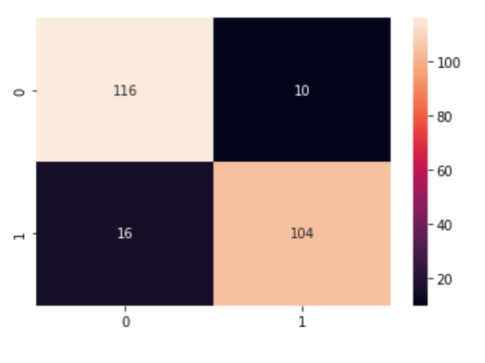
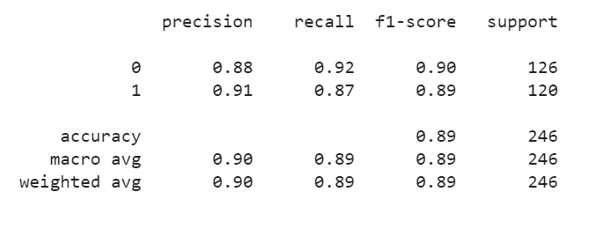
Decision Tree
Before balancing the Data the accuracy is Accuracy = 100% , with low F1-score
After balancing the Data the accuracy is Accuracy = 89%
F1-Score: (0.89 & 0.90)
Classification Report :
Heatmap of confusion Matrix

Slide 31
Supervised Machine Learning Algorithms
From scikit-learn Library of python
Random Forest
AdaBoost
Naive Bayes

Slide 32
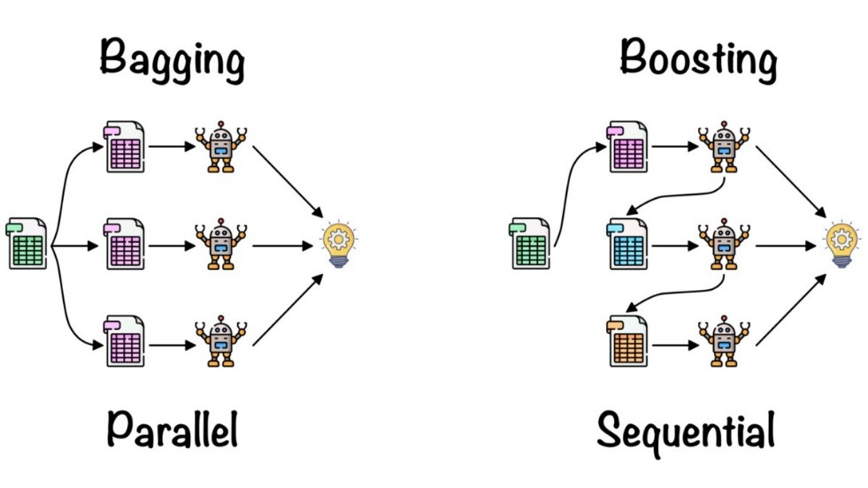
Ensemble Learning
Bagging
Random Forest
Boosting
AdaBoost

Slide 33
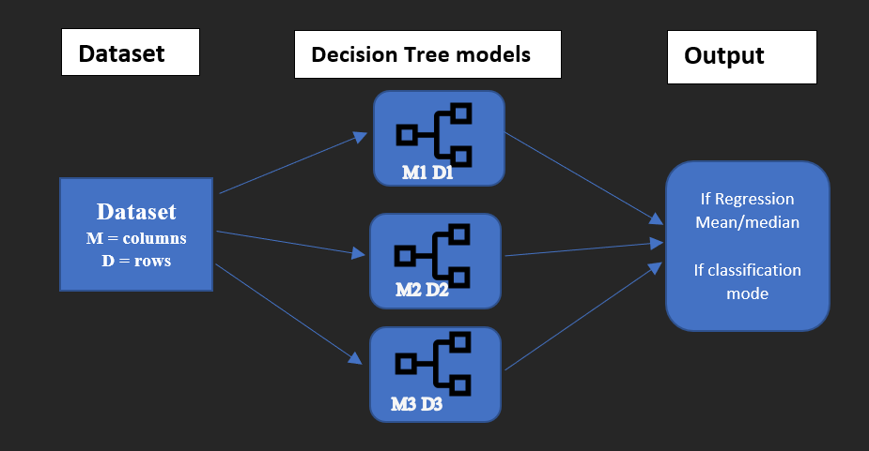
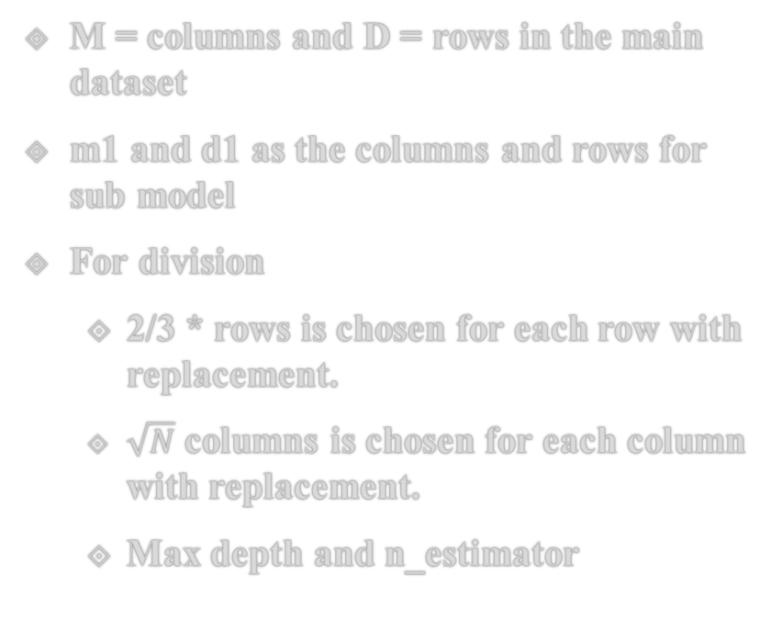
Random Forest
M = columns and D = rows in the main dataset
m1 and d1 as the columns and rows for sub model
For division
2/3 * rows is chosen for each row with replacement.
$\sqrt{N}$ columns is chosen for each column with replacement.
Max depth and n_estimator
Hyper parameter: Grid Search cv ; cv =5

Slide 34
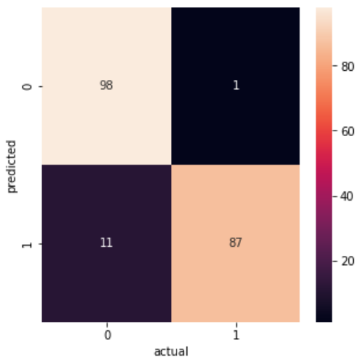
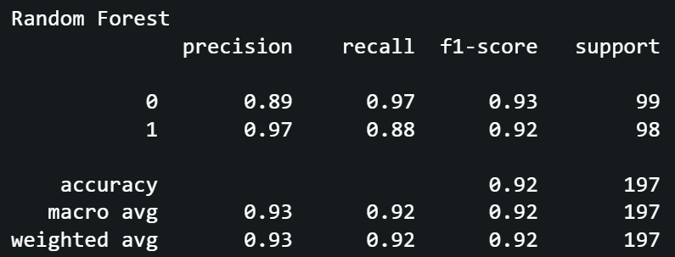
Random Forest
Heatmap of confusion Matrix
Classification Report
Accuracy: 92%
F1 Score: (0.93 and 0.92)

Slide 35
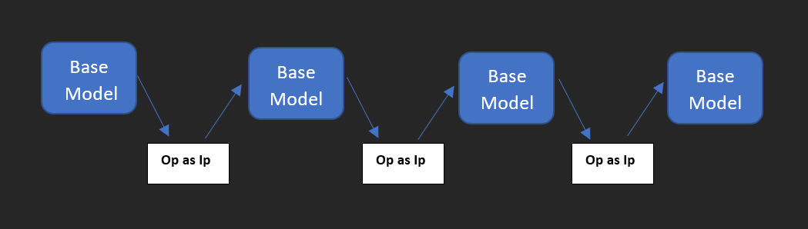
AdaBoost
Base_estimator = base model
N_estimator = number of base models
Learning rate = level of pace to learn
For each row the weight is assigned by the formula 1 / (no. of rows)

Slide 36

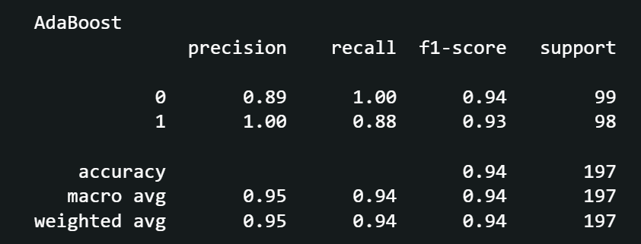
AdaBoost
Heatmap of confusion Matrix
Classification Report
Accuracy: 94%
F1 Score: (0.94 and 0.92)

Slide 37


Naive Bayes
Bayes Theorem: -
P(B/A) = $\frac{P(B) ∗ P(A/B)}{P(A)}$
Analysing: - let say X = A and y = B
X₁, X₂, X₃, … X_{n} = A
y = B
Probability Formula: -
P (y / X₁, X₂, X₃, … X_{n}) = $\frac{P\left(y\right)∗P(\frac{X1, X2, X3, … Xn }{y})}{P(X1, X2, X3, … Xn )}$
Case 1: -
P (Yes / X₁, X₂, X₃, … X_{n}) = $\frac{P\left(Yes\right)∗P(\frac{X1, X2, X3, … Xn }{Yes})}{P(X1, X2, X3, … Xn )}$
Case 2: -
P (No / X₁, X₂, X₃, … X_{n}) = $\frac{P\left(No\right)∗P(\frac{X1, X2, X3, … Xn }{No})}{P(X1, X2, X3, … Xn )}$

Slide 38
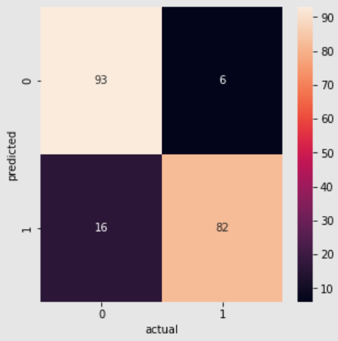
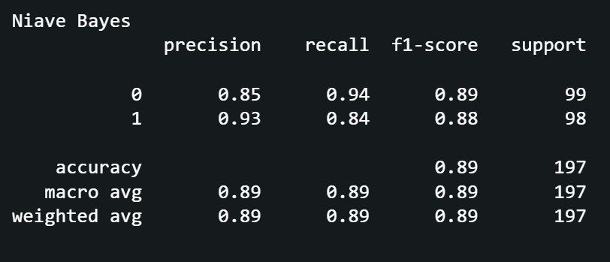
Naive Bayes
Heatmap of confusion Matrix
Classification Report
Accuracy: 89%
F1 Score: (0.89 and 0.88)

Slide 39
References
https://scikit-learn.org/stable/getting_started.html
https://chat.openai.com/chat
https://youtu.be/NCgjcHLFNDg
https://youtu.be/9BkvhbjDweo

Slide 40
conclusion
Now the given algorithms can effectively detect credit card fraud by learning from labeled data, achieving high accuracy, precision, and recall.
The performance of different supervised machine learning algorithms may vary depending on the dataset size, distribution, feature selection, hyperparameters tuning, and evaluation metrics used.
Further research can explore ensemble methods, feature engineering, deep learning models to enhance the performance, interpretability, and practicality of credit card fraud detection using supervised machine learning.

Slide 41
Thankyou

